Slide 1


Optimizing Walmart Sales Performance : Predictive Modeling Using Key Business Indicators
HEMANTH KUMAR KOTTAPALLI
HEMENATH KOTTAPALLI
SAI VAMSHIDHAR REDDY SALLA
SRIRAM REDDY VANGA

Slide 2


Table Of Content
01.
02.
03.
04.
05.
06.
Key Insights & Analysis
Model Evaluation
Conclusion
Business Strategy & Objectives
Dataset Overview
Data Transformation Process

Slide 3

Strategic Insights and Business Goals
Opportunity
Peak seasons present significant revenue potential but require precise promotional strategies to capitalize on dynamic consumer behavior
Challenge
Current promotional efforts often miss the mark, leading to inefficiencies and untapped growth opportunities
Objective
Leverage advanced analytics to forecast sales trends and optimize promotions, driving profitability and customer satisfaction

Slide 4

Dataset Profile
INCLUDES FUTURE PERIODS FOR SALES PREDICTION
Test
Store
Date
IsHoliday
Stores
DETAILS ABOUT WALMART STORES
Store
Type
Size
CONTAINS HISTORICAL SALES DATA FOR WALMART STORES
INCLUDES INFORMATION ON ECONOMIC AND PROMOTIONAL FACTORS.
Train
Store
Date
and IsHoliday
Weekly_Sales
Features
Date
Temperature
Fuel_Price
CPI
Unemployment
MarkDown1-5

Slide 5
Data Preparation and Transformation Overview
Data Quality and Imputation Process
Feature Engineering and Data Standardization
Merged Dataset Overview
Dataset Integration:
Train and test datasets merged with feature and store data.
Training Dataset:
Records: 421,570
Variables: 17
Testing Dataset:
Records: 115,064
Variables: 16
Comprehensive datasets ready for analysis and forecasting.
Columns with Missing Values:
CPI, Unemployment, and Markdown
Imputation Techniques:
Missing values were replaced with medians.
Negatives and remaining missing values were replaced with 0.
Ensured complete and clean datasets for accurate modeling.
Seasonality Features Created:
Week, Month, Quarter, and Year
Holiday Indicators:
Unified into a single IsHoliday column.
Clean and structured dataset ready for analysis.

Slide 6
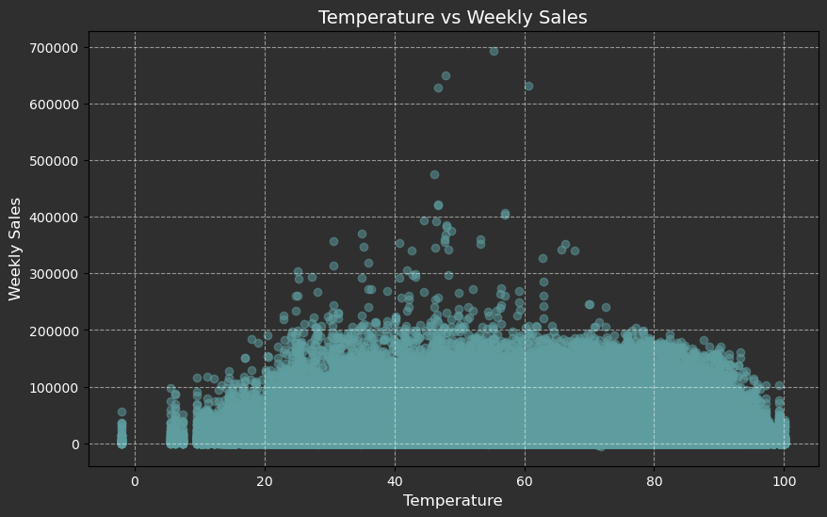
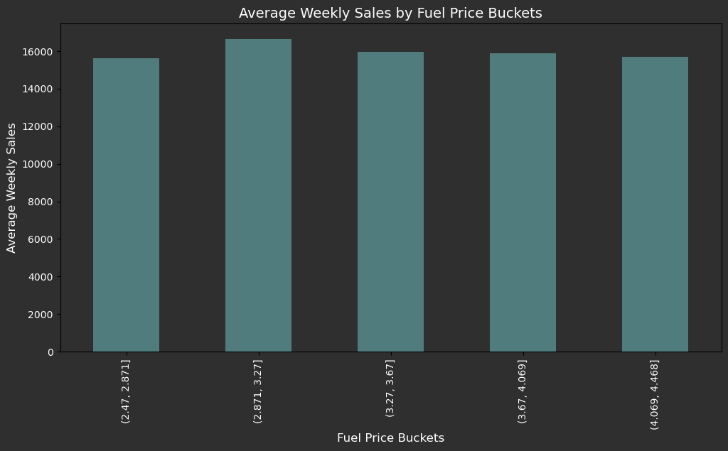
Data Insights and Analysis

Slide 7
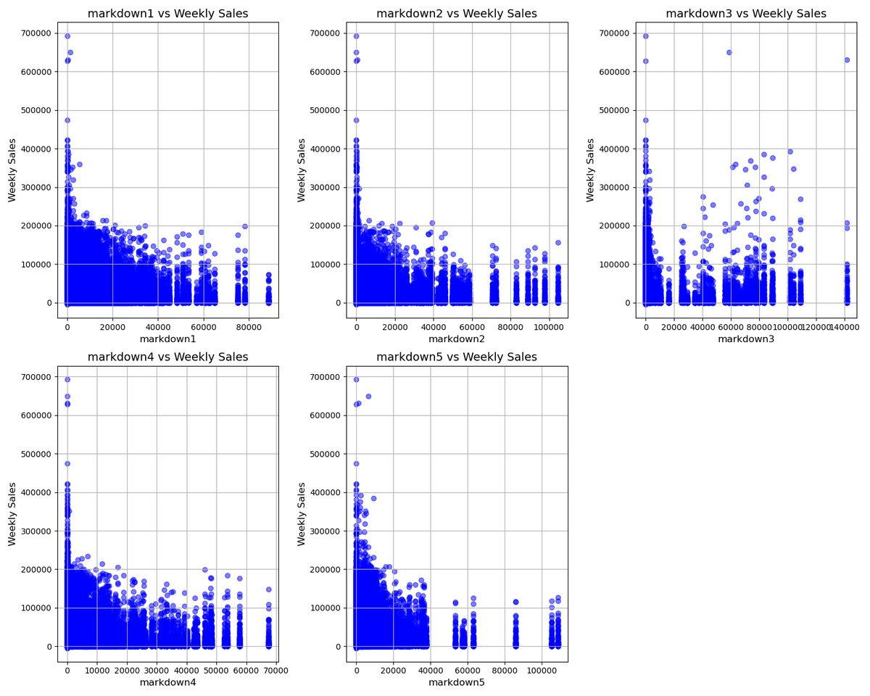
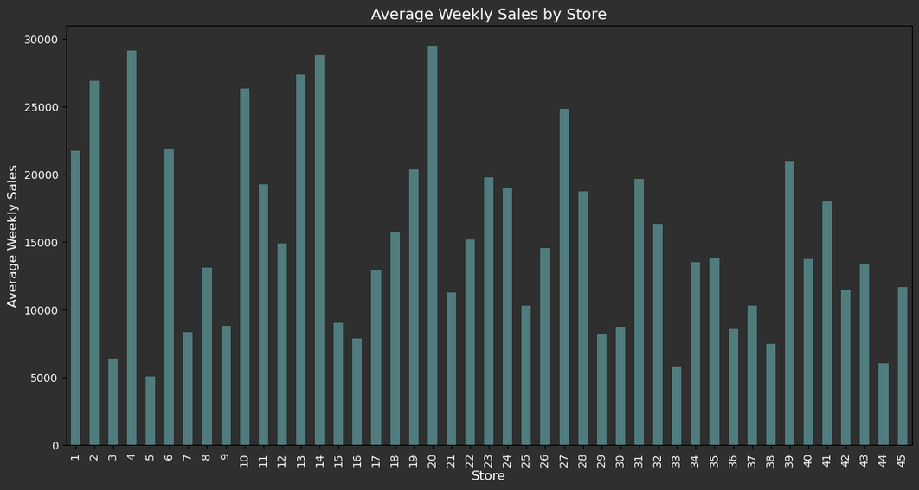
Data Insights and Analysis

Slide 8
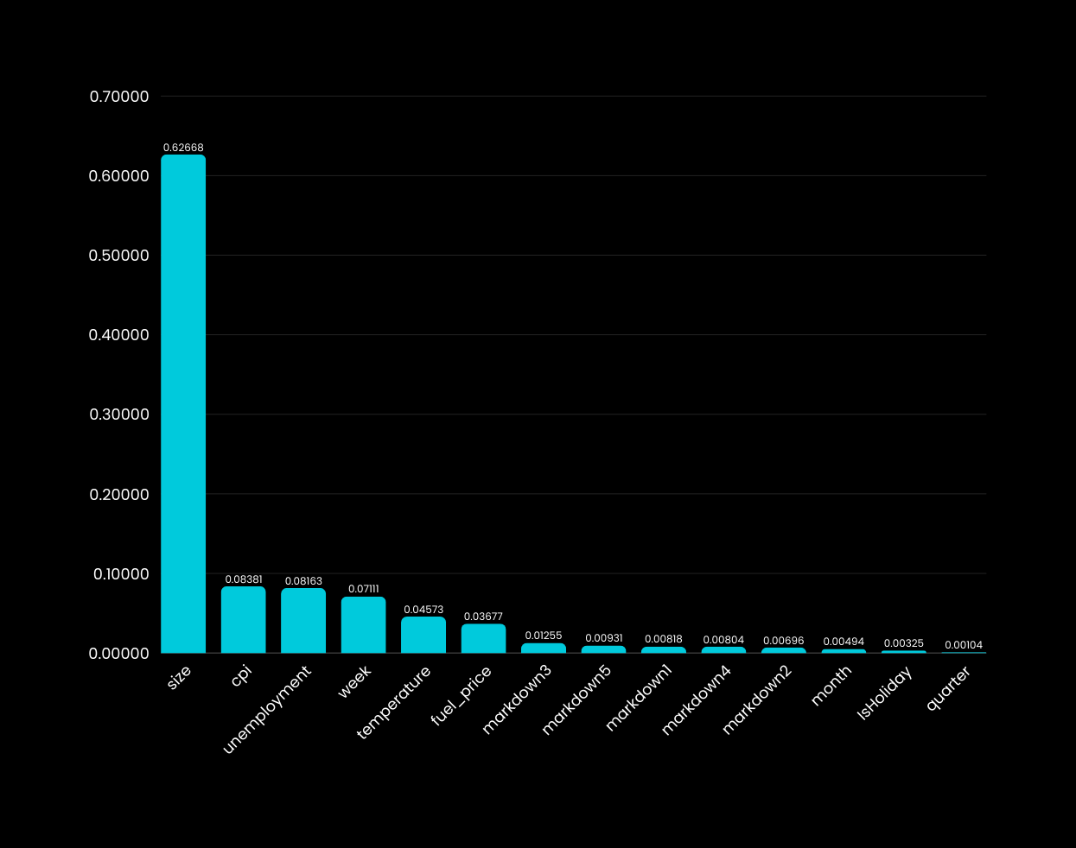


Variable selection
Key Factors
Size: Strong impact due to store capacity and traffic.
CPI & Unemployment: Reflect consumer spending trends.
Week: Captures seasonal shopping behavior.
Temperature & Fuel_Price: External factors influencing sales.
Markdown1, Markdown3, Markdown5, IsHoliday: Account for promotions and holiday effects.
Excluded Factors
Quarter & Month: Minimal impact on weekly sales.
dept: High cardinality, increases complexity and risk of overfitting.

Slide 9




Model Evaluation
Model
MAE
RMSE
MAE and RMSE are used over accuracy-based metrics as they better evaluate prediction errors in sales forecasting
LightGBM
14250.25
21694.54
XGBoost
14322.65
21801.52
Decision Tree
14442.26
21960.78
Linear Regression
14507.59
22089.64

Slide 10
How Walmart Can Leverage Our Analysis to Optimize Promotional Strategies
TEMPERATURE-RELATED SCENARIOS
SCENARIO | TEMPERATURE | HOLIDAY | CHANGE IN TOTAL SALES (%)
MARKDOWN IMPACT (50% INCREASE) | 96 | None | -4.01%
MARKDOWN IMPACT (50% INCREASE) | 96 | True | -2.14%
MARKDOWN IMPACT (50% DECREASE) | 96 | None | -4.64%
MARKDOWN IMPACT (50% DECREASE) | 96 | True | -2.64%
SCENARIO | TEMPERATURE | HOLIDAY | CHANGE IN TOTAL SALES (%)
MARKDOWN IMPACT (50% INCREASE) | 16 | None | -2.54%
MARKDOWN IMPACT (50% INCREASE) | 16 | True | -0.82%
MARKDOWN IMPACT (50% DECREASE) | 16 | None | -2.81%
MARKDOWN IMPACT (50% DECREASE) | 16 | True | -0.85%

Slide 11
How Walmart Can Leverage Our Analysis to Optimize Promotional Strategies
FUEL PRICE-RELATED SCENARIOS
SCENARIO | FUEL PRICE | HOLIDAY | CHANGE IN TOTAL SALES (%)
MARKDOWN IMPACT (50% INCREASE) | 3.91 | None | -0.68%
MARKDOWN IMPACT (50% INCREASE) | 3.91 | True | 1.92%
MARKDOWN IMPACT (50% DECREASE) | 3.91 | None | -0.90%
MARKDOWN IMPACT (50% DECREASE) | 3.91 | True | 2.26%
SCENARIO | FUEL PRICE | HOLIDAY | CHANGE IN TOTAL SALES (%)
MARKDOWN IMPACT (50% INCREASE) | 2.66 | None | 0.12%
MARKDOWN IMPACT (50% INCREASE) | 2.66 | True | 0.91%
MARKDOWN IMPACT (50% DECREASE) | 2.66 | None | -0.04%
MARKDOWN IMPACT (50% DECREASE) | 2.66 | True | 1.35%

Slide 12
How Walmart Can Leverage Our Analysis to Optimize Promotional Strategies
UNEMPLOYMENT-RELATED SCENARIOS
ADVANCEMENT
SCENARIO | UNEMPLOYMENT | HOLIDAY | CHANGE IN TOTAL SALES (%)
MARKDOWN IMPACT (50% INCREASE) | 3.1 | None | 15.69%
MARKDOWN IMPACT (50% INCREASE) | 3.1 | True | 17.85%
MARKDOWN IMPACT (50% DECREASE) | 3.1 | None | 13.84%
MARKDOWN IMPACT (50% DECREASE) | 3.1 | True | 16.62%
Optimized Inventory Alignment with Demand Forecasts
Continuous Feedback Loop for Promotional Refinement
Personalize Regional Promotional
Strategies

Slide 13
Thank You

Slide 14
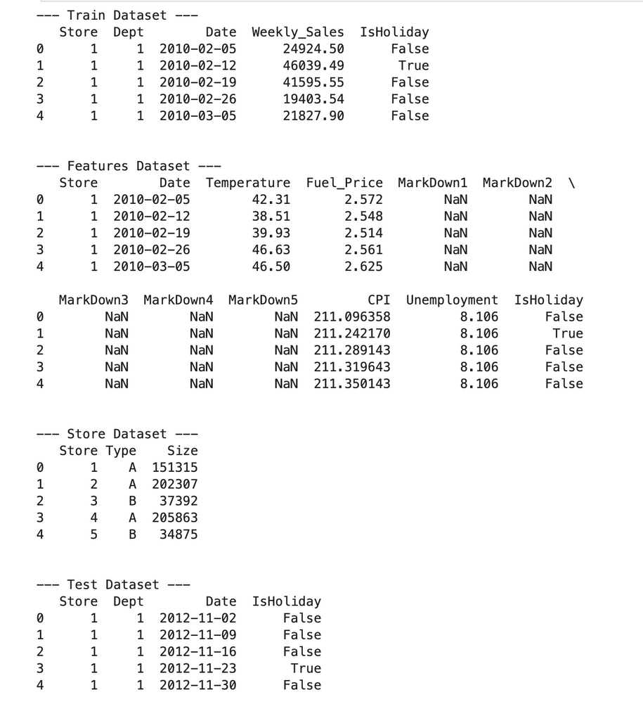
Appendix

Slide 15
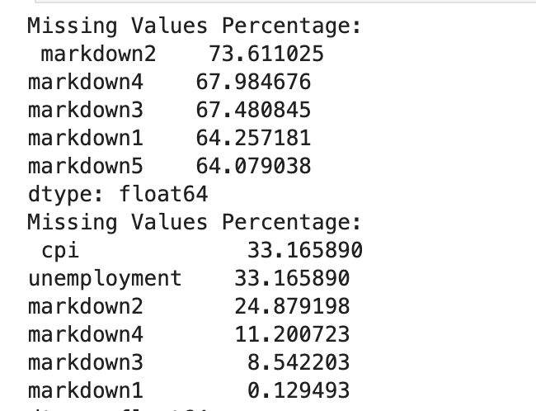
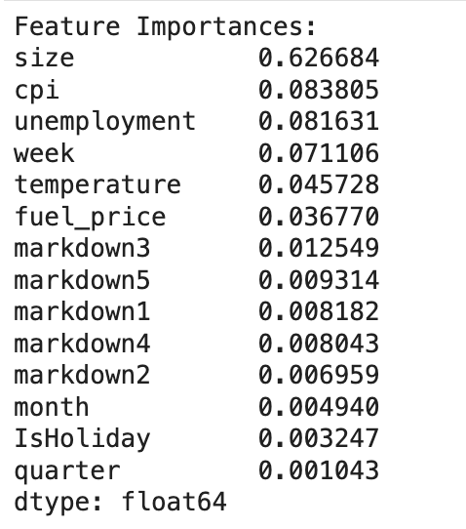

Slide 16
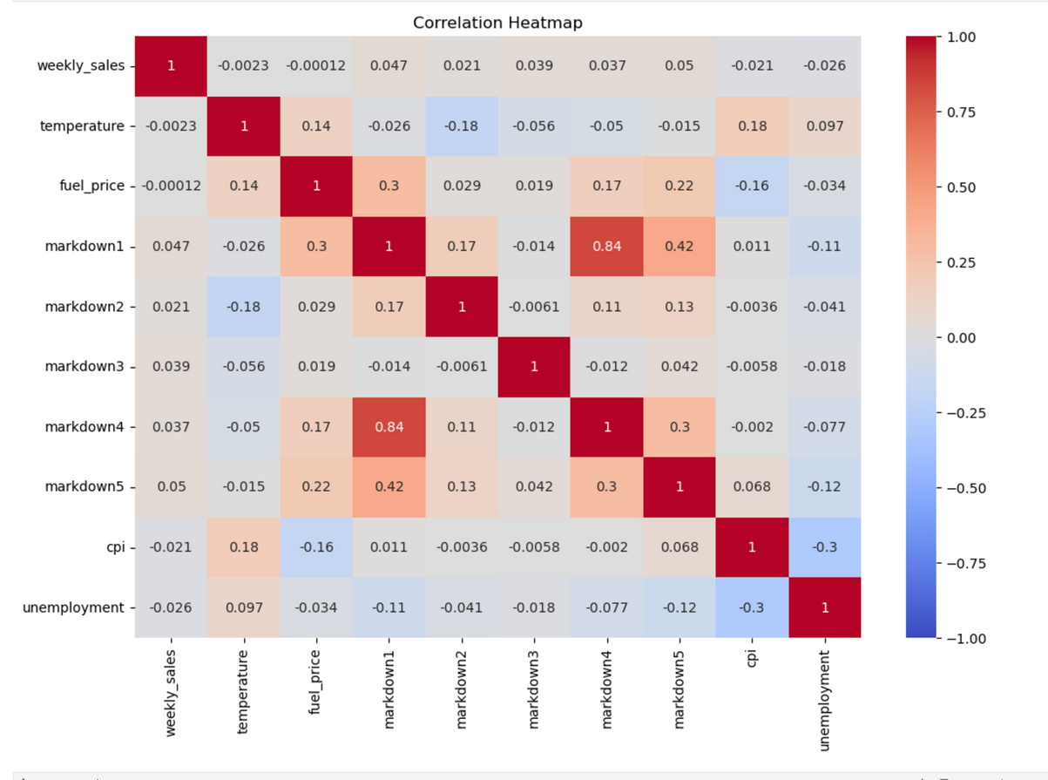

Slide 17



Slide 18
